Slide 1

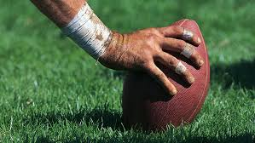
Ravens: How to Increase Expected Points per Play

Slide 2
Step 1: Project Idea
The dataset was provided by Kaggle
It consisted of multiple datasets that collected data from the whole National Football League (NFL)
It had over 500,000 worth of data
The initial idea was:
How should a team, maximize the amount of yards gained (variable focused on would be playResult) through the offense’s formation or by running certain plays.
Ended up focusing on expected points added instead of play result

Slide 3
The Dataset
The link to the dataset: https://www.kaggle.com/competitions/nfl-big-data-bowl-2024/data
Since there was a lot of a data, I decided to only focus on one week’s worth of data, and then randomly sampled 500 observations.
I also decided to focus on one team:
The Baltimore Raven

Slide 4
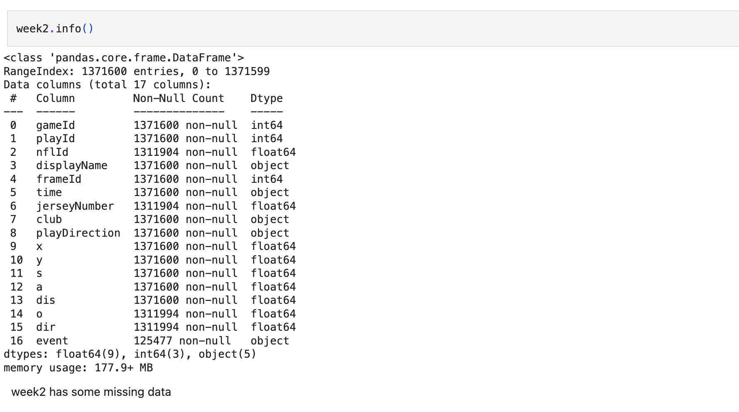
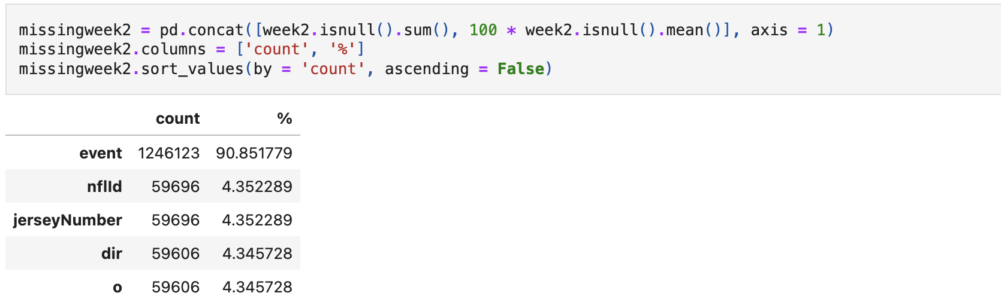
Step 2: Data Wrangling
This takes a look at week 2 of the season before it was cleaned, and merged with other datasets. There is a lot of missing values throughout the dataset. So a lot of work was done to make this code useable.

Slide 5
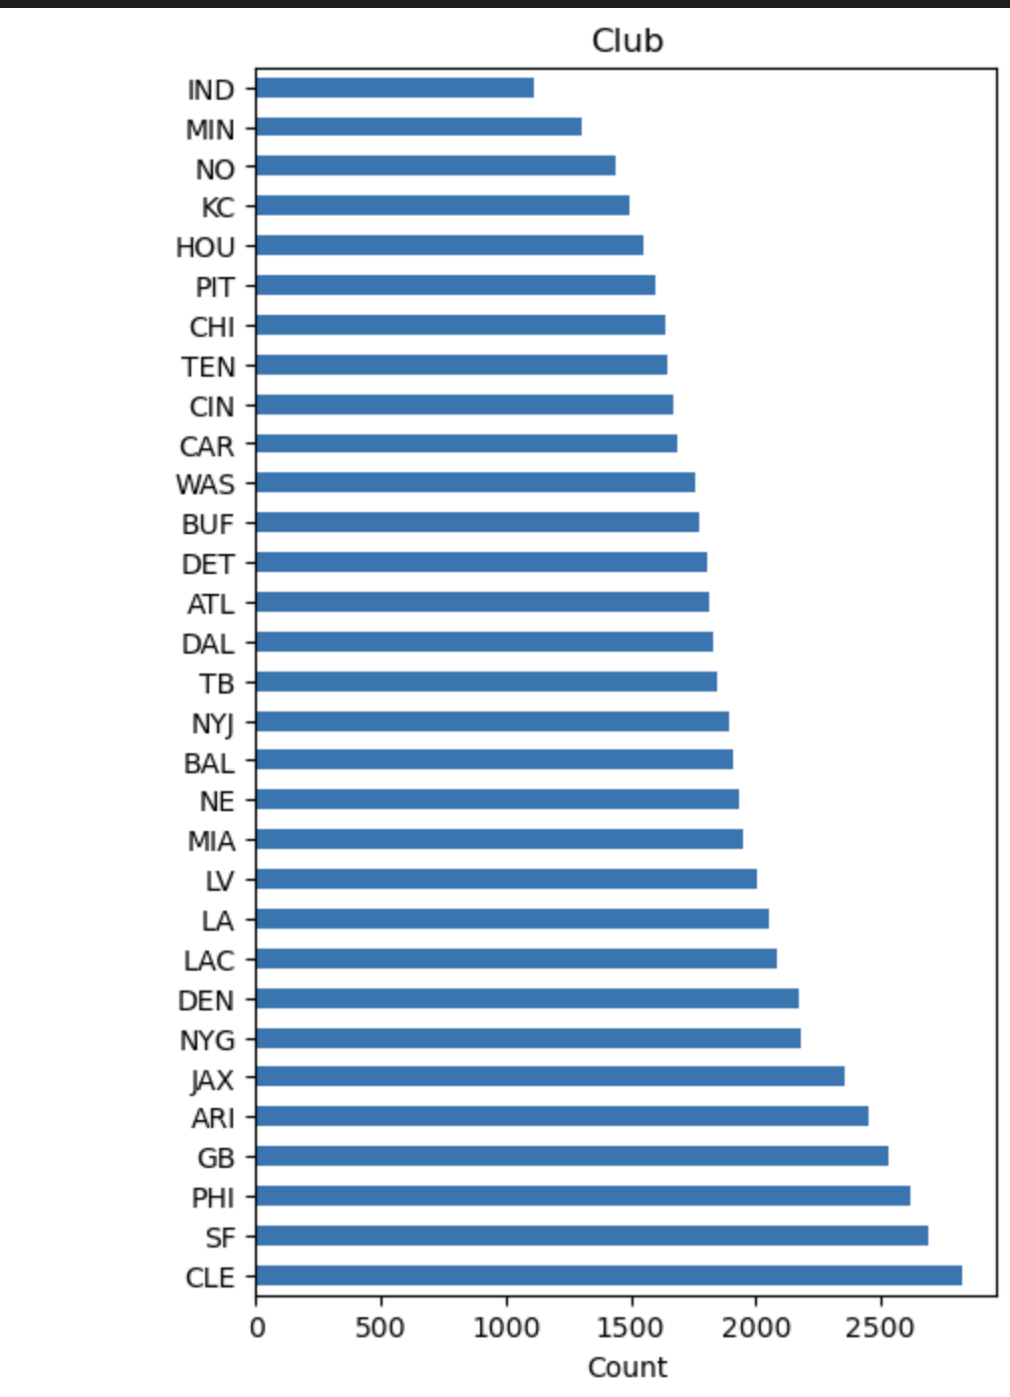
This is a graph on the counts per team, our main focus, ‘BAL’, has a good amount of observations

Slide 6
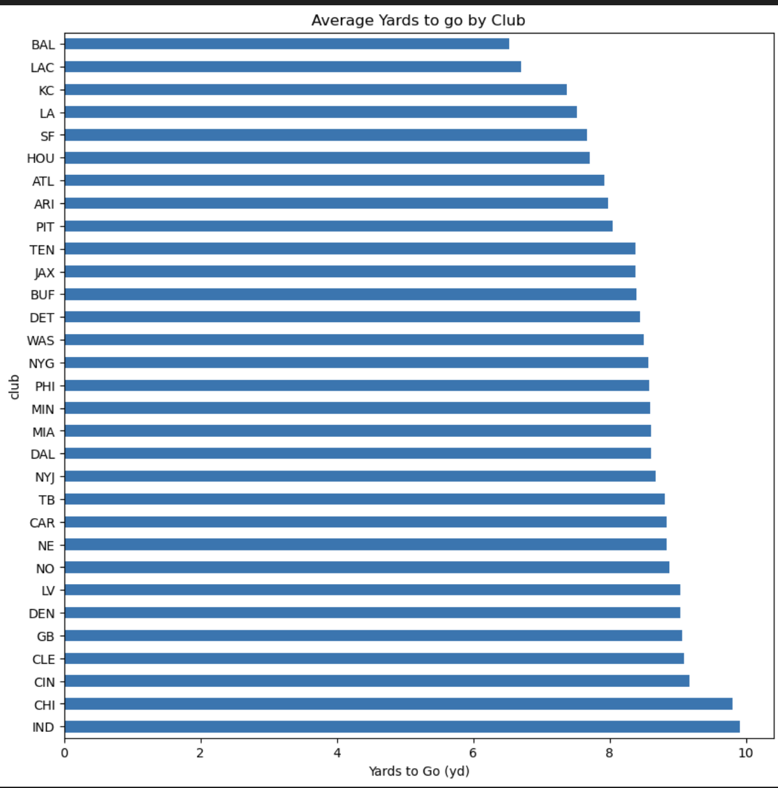
This is the average yards to go by each team. The less yards, the better. BAL having the least, is good!

Slide 7
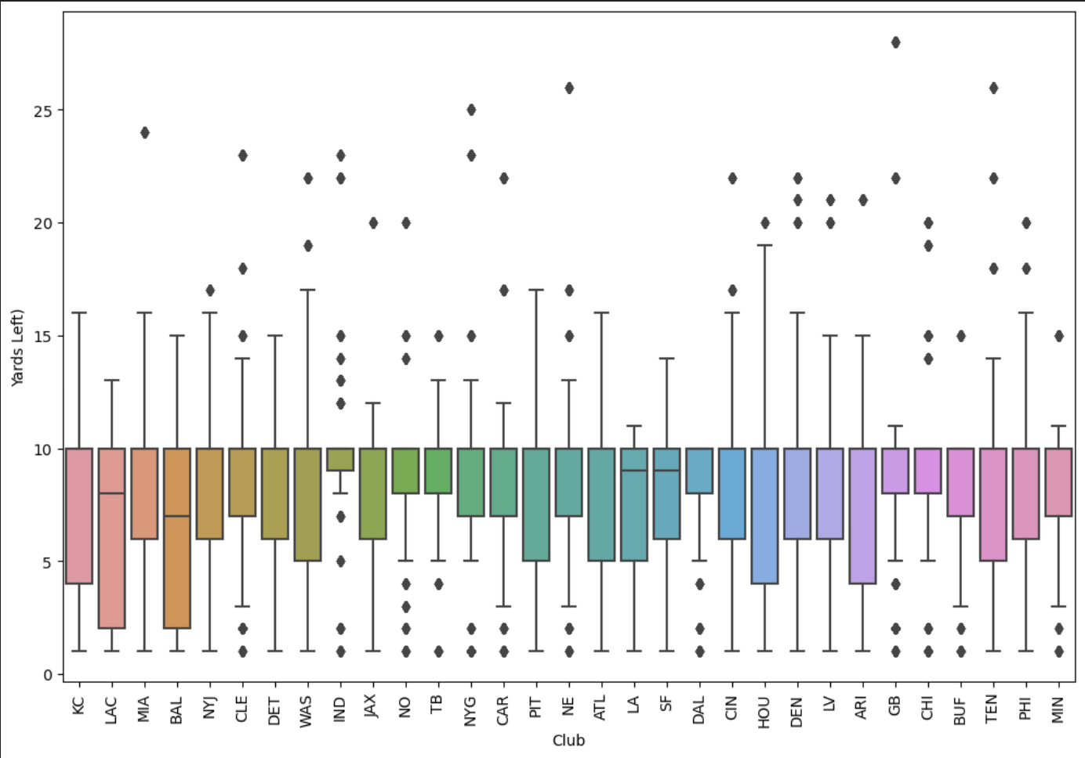
This a box-plot of the same data, there seems to be a lot of outliers for each team.

Slide 8
Step 3: EDA
The next step is EDA. In this step here are the main focus:
Looked at various variables to figure out what would be our outcome variable would be
Figure out any potential relationship between the variables

Slide 9
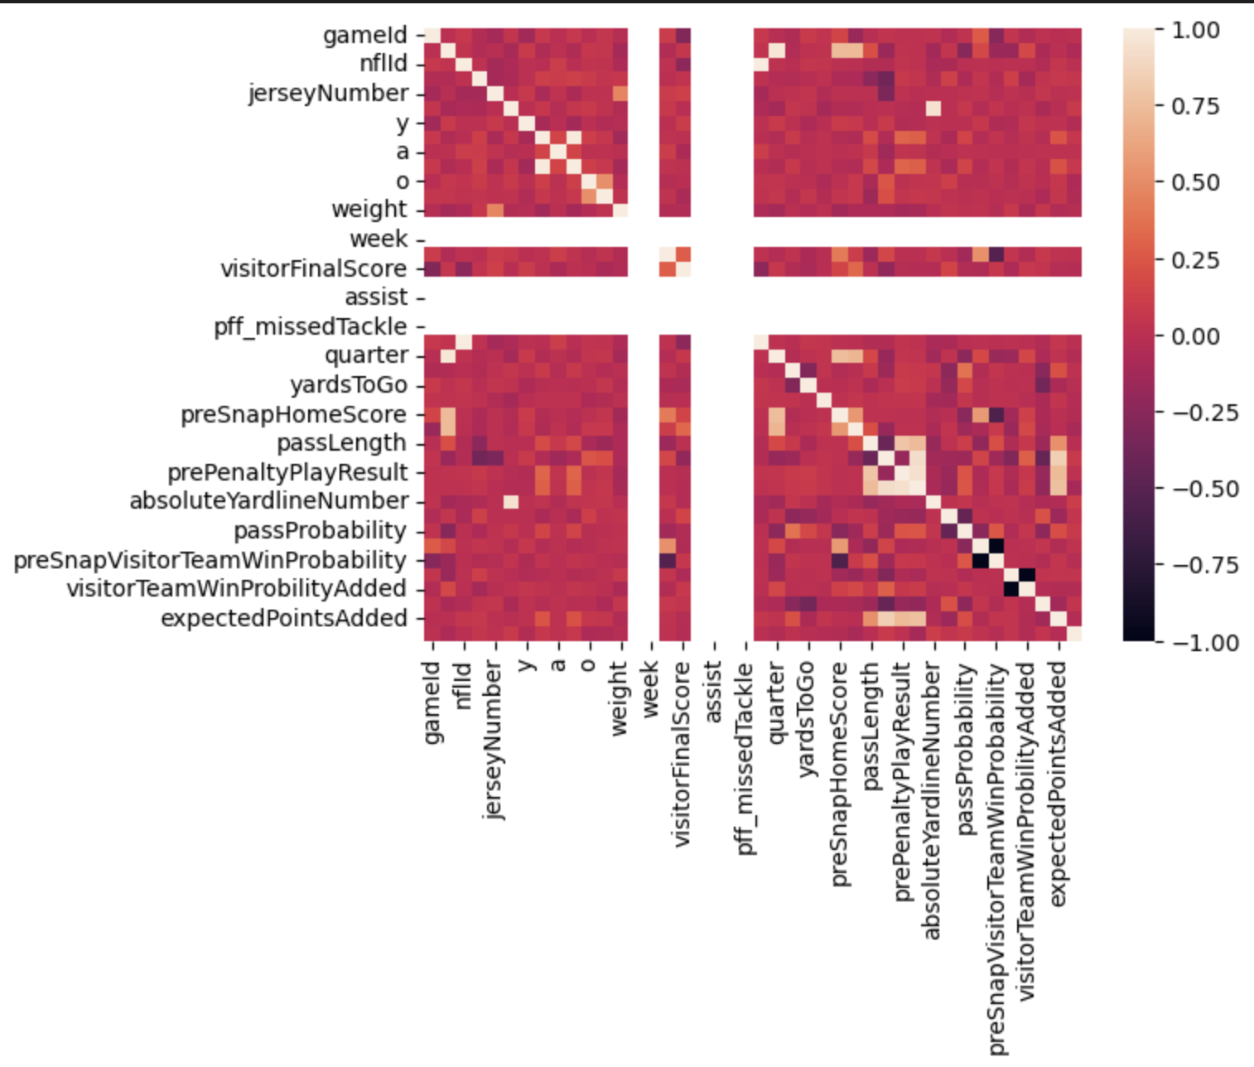
This graph shows the relationship between the variables. There does seem to be some relationship between various variables.

Slide 10
Step 4: Pre-processing and Training
I also finalized the dataset I was going to used and turned the offense formation column into a dummy variable.
In this step this is where the data is split into test and training datasets. I used a 70 training / 30 testing data split.
Then some code was done to figure out the best parameters for the model, which was:
StandardScaler()
SimpleImputer() with a the mean as its strategy
RandomforestRegressor() with the n_estimator of 112
The top 4 variables that influence the expected points added were:
playResult
prePenaltyPlayResult
yardsToGo
down

Slide 11
Step 5: Modeling
This is where the data was fitted into the best model, and then different scenarios were ran with that model.
Scenario 1:
Changing the play results to see how it would affect expected points added
Scenario 2:
Play ran gave us a 4 yard gain, and only have 6 more yards to go at a second yard.
Scenario 3:
The play ran gave us a 14 yard gain (lost 2 yards due to a foul), and only have 10 more yards to go at a first yard.
Overall, the best formation that did the best in each scenario was the Shotgun formation.

Slide 12
Conclusions and Recommendations
After running various modeling methods, the best model suggests that the best formation that the Baltimore Ravens uses is the shotgun formation. Each time they used this formation, the average expected points was the highest in the last two scenarios where formation was tweaked. Although this is the best formation for the team, this could change with injuries, confidence, and the opposing team figuring out their formation if used too often. I would suggest using this play when in dire need of points.

